Slide 1
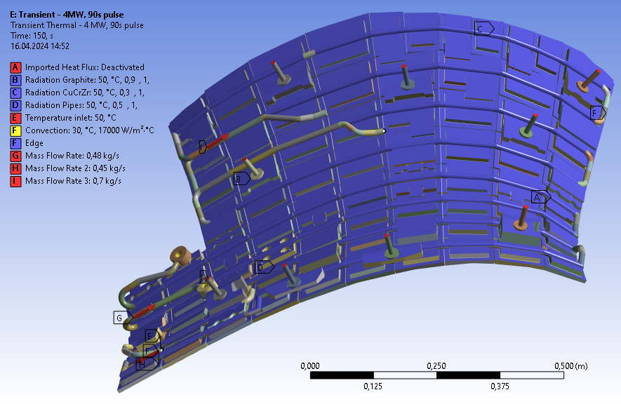
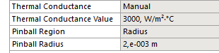
Heat shield simulation
Bolts attaching HS to PV – fixed to 30 °C
Inlet temperature 30 °C ,
pipe convection 17 000 W/m2C
Water flow in pipes simulated using Fluid
Beam elements = known dT per module
Sigraflex simplyfied to contact:
Radiation from heat shield to PV considered
Including pipes, heat sinks and graphite
flow rates (applied only on HSs) predicted by KiP: Hydraulic calculation of 1st wall cooling loops (OP1 and OP2) 29HDQV v2.0

Slide 2
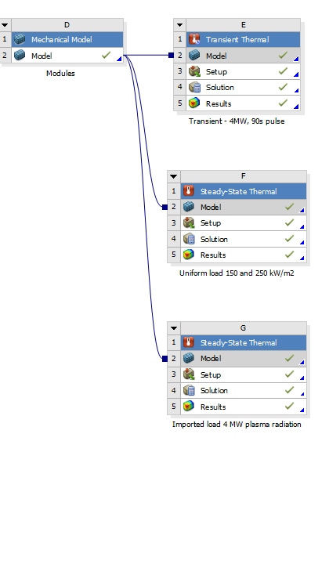
Heat load to plasma facing graphite tiles
4 MW, 90s – heat load profile is imported from a separate simulation – shown on the next slide
Uniform heat flux 250 𝑘𝑊/𝑚 and 150 𝑘𝑊/𝑚2 by Specification of Design Loads for In-vessel Components of W7-X, 2AYMBW
4MW imported heat load profile, steady state solution

Slide 3
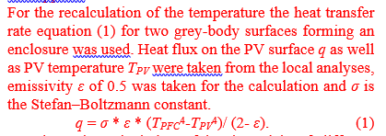
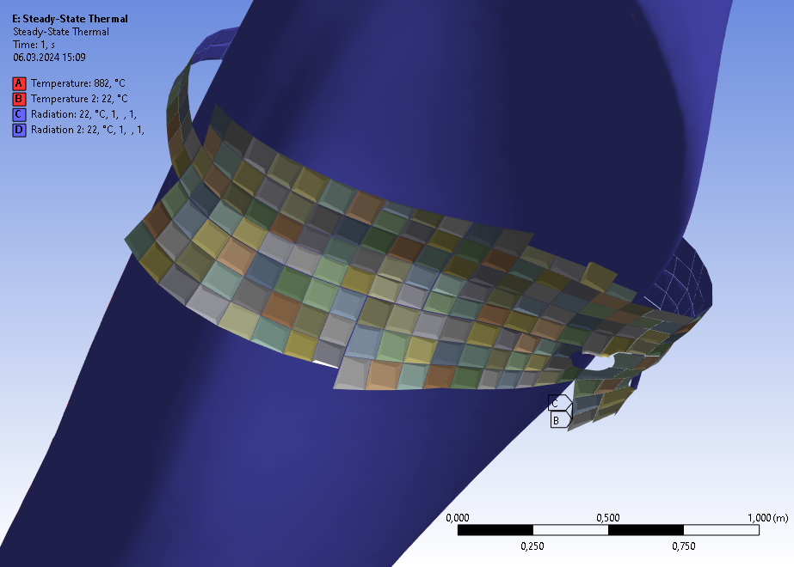
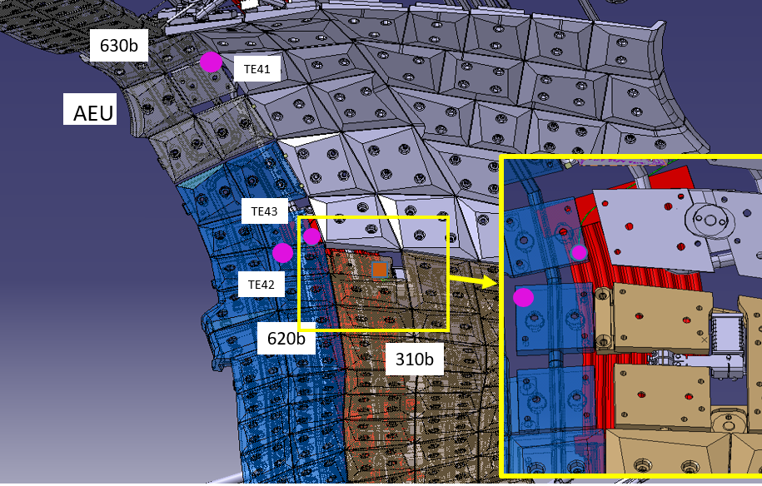
Heat flux profile on the first wall - simulation
Abschirmhaus HM 31/40 (41/50)
10 MW power ~ 100 kW/m2 load
↓
Plasma last closed surface – 882 °C
First wall surface – 22 °C
→ heat load profile on the FW
QXD31CT403
Pt 1000 sensor
AEU port
HS thermocoupels 41 to 43

Slide 4
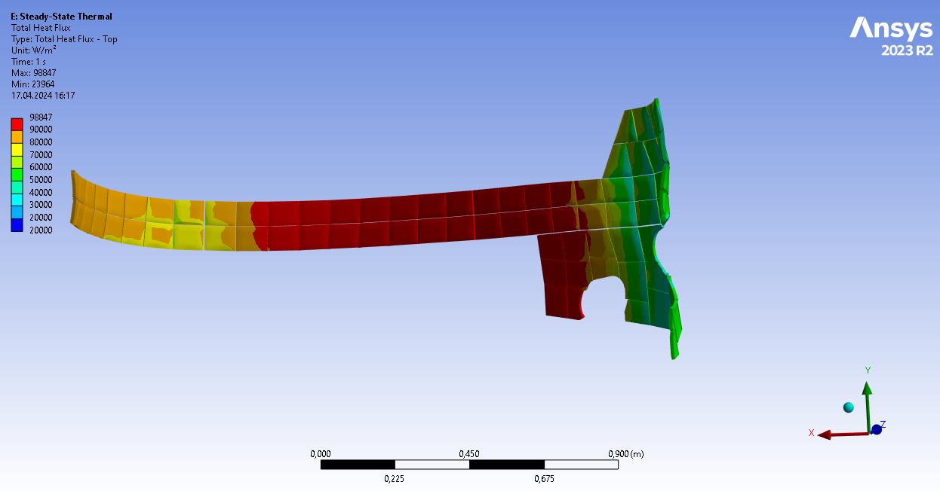
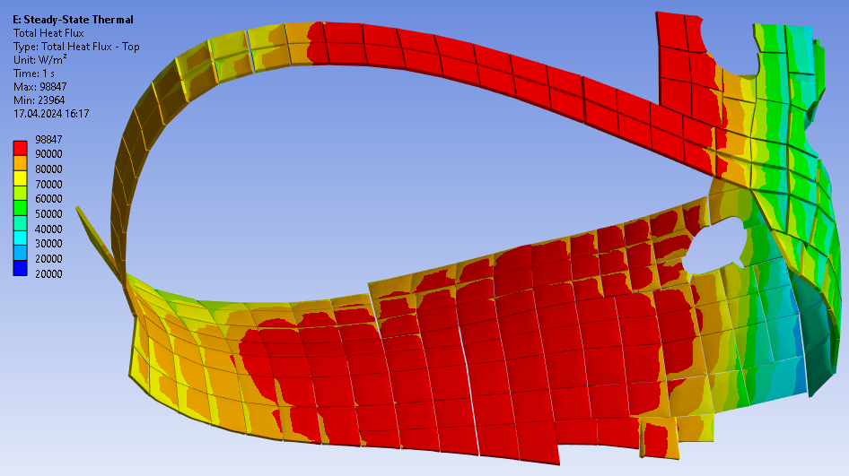
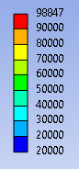
10 MW heat flux profile

Slide 5
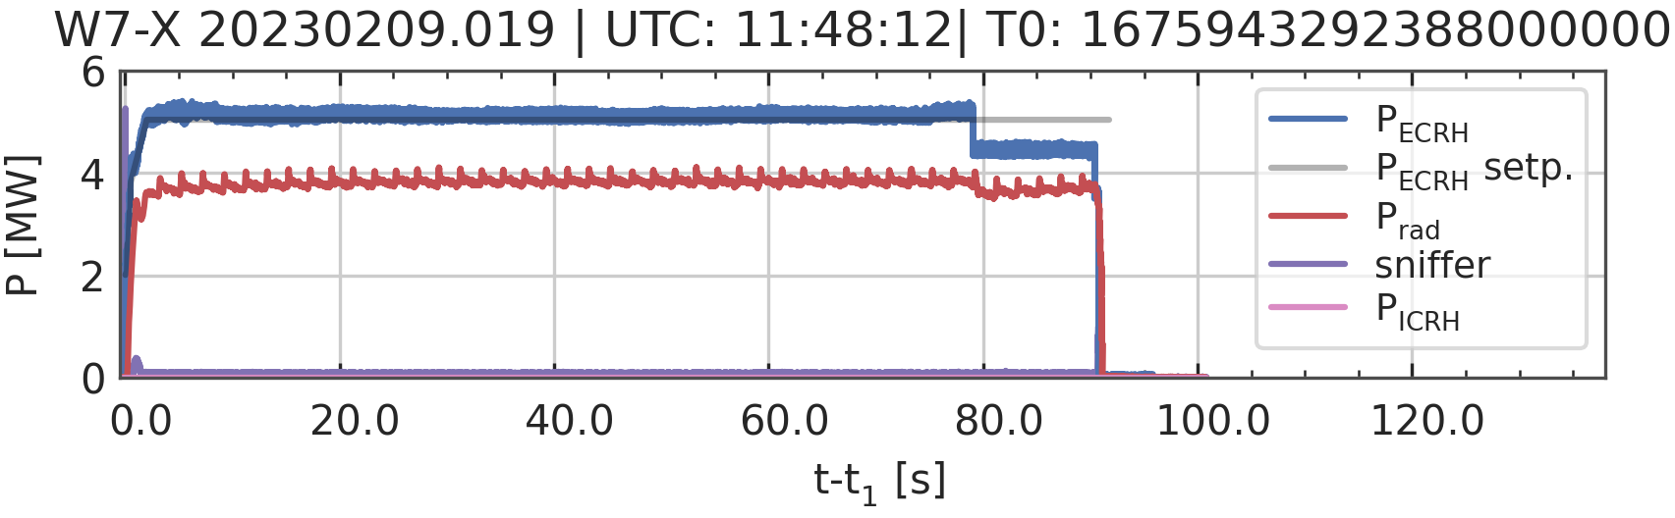

Scaling the heat flux load for a specific pulse
10 MW Power resulting in heat flux distribution ranging from 20 to 99 kW/m2.
To use this profile for specific pulses, we need to scale down the load by multiplying it by coefficient.
Scaling the resulting HF profile
4 MW Power
For pulses with good detachment!

Slide 6
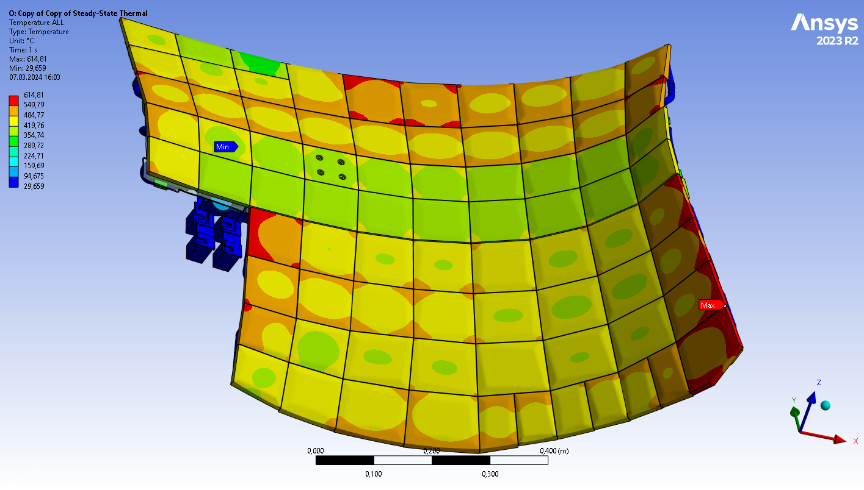
250 kW/m2 unifrom heat load
HS cooling pipes – water fluid elements simulated with mass flow rates predicted by KiP Hydraulic Calculation 29HDQV v2.0
Uniform load 250 MW/m2.
Radiative load to PV with its cooling pipes is solved in a separate project.
Solved for steady state.
Heat load profile simulated separately using the last closed plasma surface and then applied to the simulation.
CT402
Steady state solution, 250 MW/m2

Slide 7
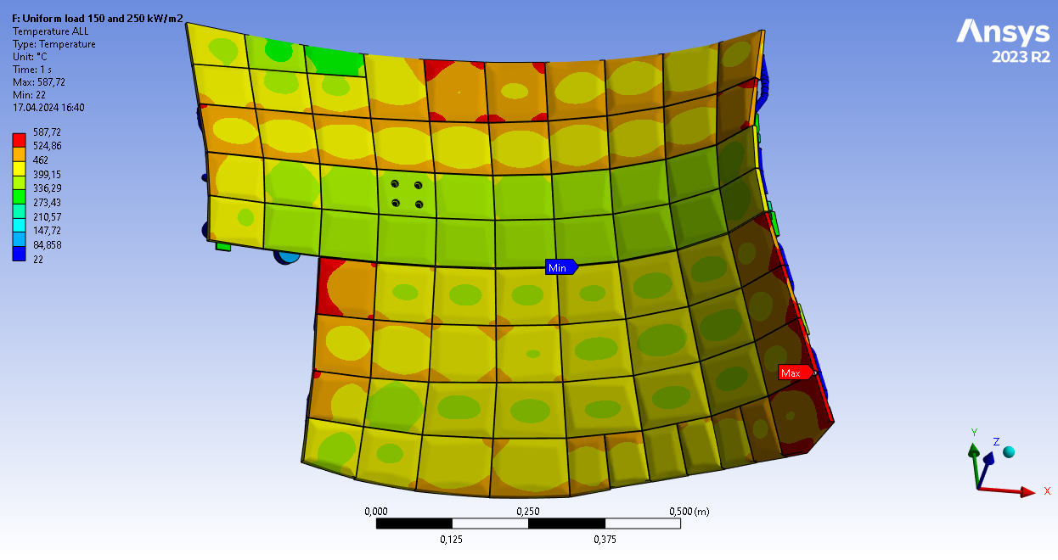
150 kW/m2 unifrom heat load

Slide 8
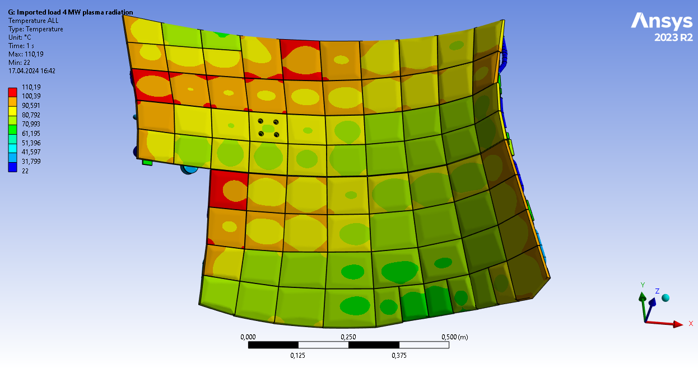
4MW heat load profile

Slide 9
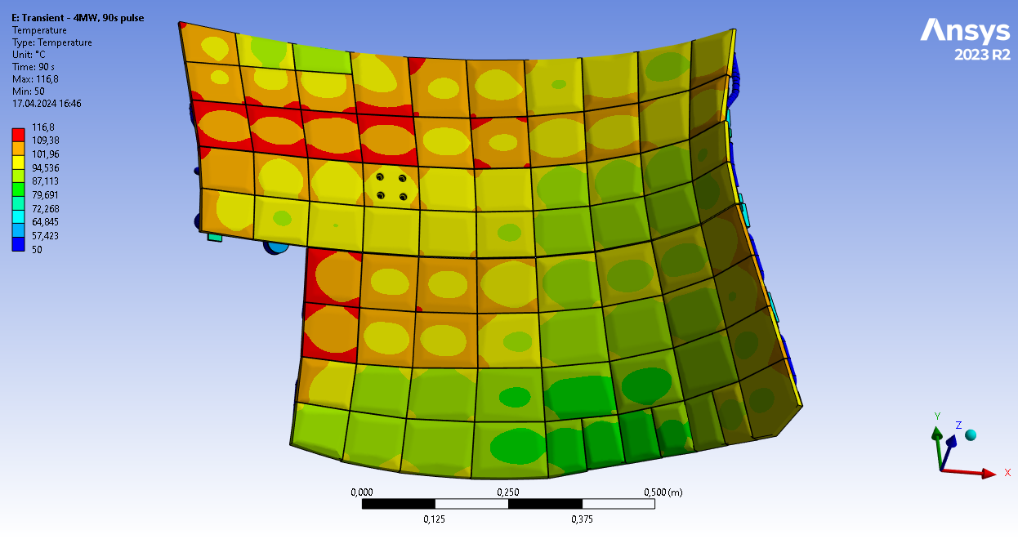
4MW heat load profile, 90s

Slide 10
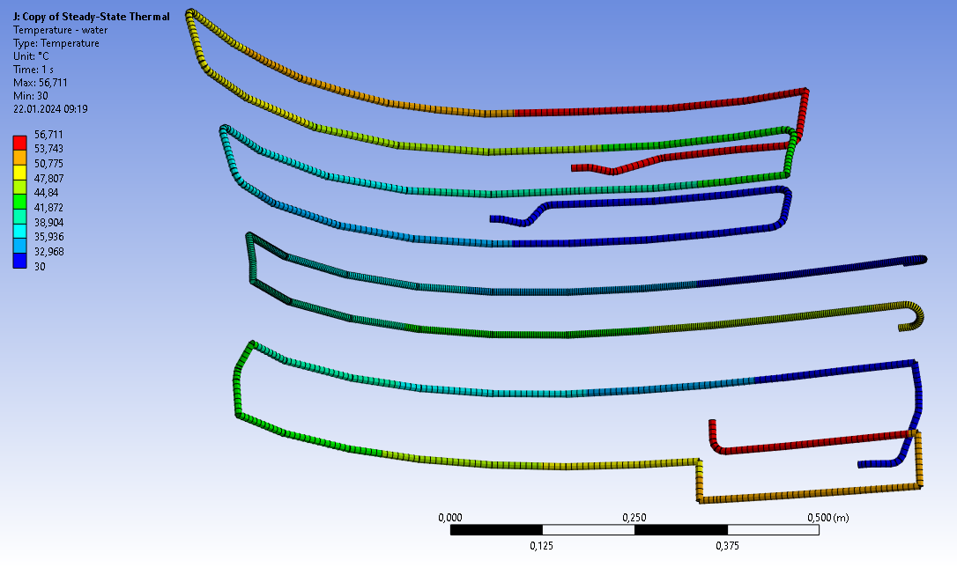
Results: cooling water heat up
 | DT [K] predicted by 29HDQV v2.0 | DT [K] Workbench result 250 kW/m2 | DT [K] Workbench result 150 kW/m2 | Flow rate [l/s]
H77 1-ACH31AC610b | 10 | 18,5 | 11,1 | 0,48
H34 1-ACH31AC560b | 16 | 27,1 | 16,4 | 0,45
H81 1-ACH31AC570b | 19 | 27,1 | 16,4 | 0,7
H81 1-ACH31AC570b
H77 1-ACH31AC610b
H34 1-ACH31AC560b

Slide 11
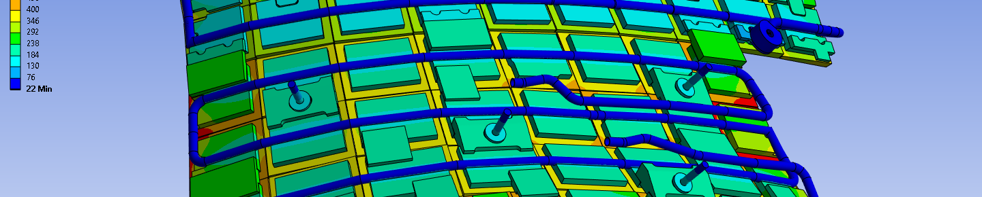
Results: Heat balance & radiation towards PV – 250 kW/m2
 | PF heat [W] | Ratio of PF heat | Area [m2] | avg. rad. heat flux [W/m2]
PF heat | 171 172,5 | 100% | 0,68469
Convection - cooling pipes | -167658 | 97,9% | 0,24492 | -
Convection - in/outlet areas of cooling pipes | -104,44 | 0,06% | 0,00999 | -
Radiation – graphite | -3116,9 | 1,82% | 0,25607 | 12172
Radiation – CuCrZr | -231,654 | 0,13% | 0,28789 | 804
Radiation – pipes | 106,431 | 0,06% | 0,14005 | 760
Radiation – connector plates | -111,531 | 0,06% | 0,10799 | 1032
Conduction – supports to vessel | -26,7 | 0,01% | 0,0007 | -
SUM | 29,66 | - |  | 4234,41

Slide 12
Results: Heat balance & radiation towards PV – 150 kW/m2
 | PF heat [W] | Ratio of PF heat | Area [m2] | avg. rad. heat flux [W/m2]
PF heat | 102 703,5 | 100% | 0,68469
Convection - cooling pipes | -101 494 | 98,8% | 0,24492 | -
Convection - in/outlet areas of cooling pipes | -63,3 | 0,06% | 0,00999 | -
Radiation – graphite | -1014,11 | 1,8% | 0,25607 | 3960
Radiation – CuCrZr | -96,38 | 0,13% | 0,28789 | 334
Radiation – pipes | -39,07 | 0,03% | 0,14005 | 279
Radiation – connector plates | -45,19 | 0,04% | 0,10799 | 418
Conduction – supports to vessel | -26,7 | 0,04% | 0,0007 | -
SUM | -17,04 | - |  | 1409

Slide 13
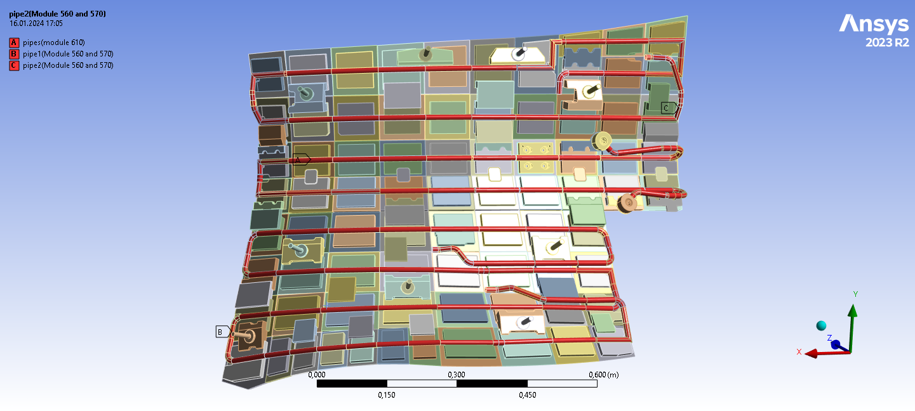
Questions
INLET / OUTLET positions
INLET
INLET
INLET

Slide 14
Heat shield simulation
The simulation was created to examined radiative heat load from HS to PV and also heat load to the Diam. Loop attached in this area.
Cooling water is simulated as a fluid beam element to observe temperature increase along the pipe.
The simulated area doesnt contain any thermocouples to validate the results.

